Slide 1
Lecture01:
SWE 311:
Computer Architecture and Organization

Slide 2
Book References
Computer Architecture and Organization by John P. Hayes, Third Edition.
Computer Organization & Architecture by William Stallings, 6th Edition.
Fundamentals of Digital Logic with Verilog Design by Stephen Brown & Zvonko Vranesic.
Digital Principles and Applications by Albert Paul Malvino and Donald P. Leach, Fourth Edition.
Assembly Language Programming and Organization of the IBM PC by Ytha Yu and
Charles Marut.
Microprocessors and Microcomputer-Based System Design by Mohamed Rafiquzzaman.

Slide 3
The early computational aids:
1. The abacus: An abacus is a mechanical device used to aid an individual in performing mathematical calculations.
The Origin of the Abacus: The first abacus was almost certainly based on a flat stone covered with sand or dust. Lines were drawn in the sand and pebbles used to aid calculations. From this, a variety of abaci were developed; the most popular were based on the bi-quinary system, using a combination of two bases (base-2 and base-5) to represent decimal numbers.
2.Slide rule: The slide rule is a mechanical Analog Computer. The slide rule is used primarily for multiplication and division, and also for functions such as exponents, roots, logarithms and trigonometry, but typically not for addition or subtraction.
2018-05-14

Slide 4
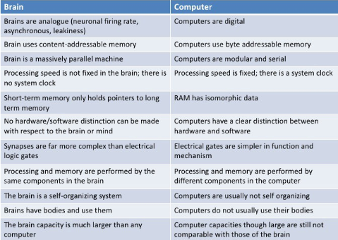
The brain versus the computer:
2018-05-14

Slide 5
Key components
    Main Memory:
    The main memory corresponds to the paper used in the manual calculation. Its purpose is to store instructions and data.
    CPU:
    The computer’s brain is its central processing unit (CPU).
    PCU:
    CPU contains a program control unit (also known as an instruction unit) whose function is to fetch instructions from memory and interpret them.
    ALU:
    An arithmetic logic unit (ALU), which is a part of CPU’s data processing or execution unit, carries out the instructions.
    Input/Output
2018-05-14

Slide 6
The Mechanical Computer
Structure of Babbage’s Analytical Engine
Arithmetic
Logic unit
(the mill)
Main Memory
(the store)
I/O Equipment
(printer and
card punch )
Data
Instruction
Program Control Unit
Operation cards
Variable cards
2018-05-14

Slide 7
PERFORMANCE ASSESSMENT
In evaluating processor hardware and setting requirements for new systems, following parameters are important
  Performance (key parameter)
  Cost
  Size
  Security
  Reliability
  Power consumption
Difficult to make meaningful performance comparisons
  Should make use of traditional performance measures
2018-05-14

Slide 8
Clock Speed and Instructions per Second
THE SYSTEM CLOCK
Operations performed by a processor, such as fetching an instruction, decoding the instruction, performing an arithmetic operation, and so on, are governed by a system clock. Typically, all operations begin with the pulse of the clock.
  The speed of a processor is dictated by the pulse frequency produced by the clock, measured in cycles per second, or Hertz (Hz)
Typically, clock signals are generated by a quartz crystal, which generates a constant signal wave while power is applied
This wave is converted into a digital voltage pulse stream that is provided in a constant flow to the processor circuitry
For example, a 1-GHz processor receives 1 billion pulses per second
The rate of pulses is known as the clock rate, or clock speed
One increment, or pulse, of the clock is referred to as a clock cycle, or a clock tick
  The time between pulses is the cycle time
2018-05-14

Slide 9
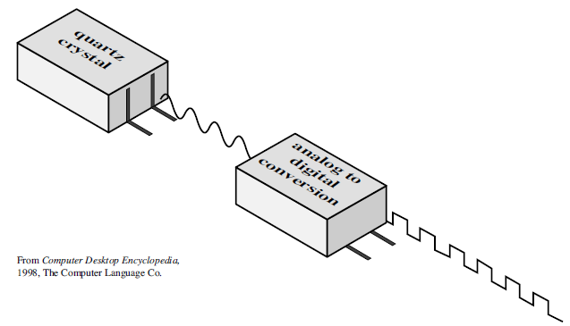
Clock Speed and Instructions per Second
2018-05-14

Slide 10
Clock Speed and Instructions per Second
The execution of an instruction involves a number of discrete steps, such as-
  fetching the instruction from memory, decoding the various portions of the instruction, loading and storing data, and performing arithmetic and logical operations
Thus, most instructions on most processors require multiple clock cycles to complete
Some instructions may take only a few cycles, while others require dozens
  A straight comparison of clock speeds on different processors does not tell the whole story about performance
2018-05-14

Slide 11
Clock Speed and Instructions per Second
INSTRUCTION EXECUTION RATE
A processor is driven by a clock with a constant frequency f or, equivalently, a constant cycle time τ, where τ = 1/f
Define the instruction count, Ic, for a program as the number of machine instructions executed for that program until it runs to completion or for some defined time interval
An important parameter is the average cycles per instruction CPI for a program
If all instructions required the same number of clock cycles, then CPI would be a constant value for a processor
On any give processor, the number of clock cycles required varies for different types of instructions, such as load, store, branch, and so on
2018-05-14

Slide 12
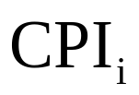

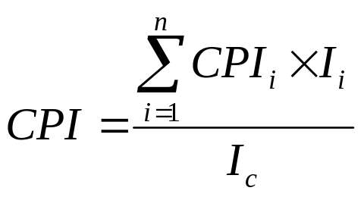
Clock Speed and Instructions per Second
Let, be the number of cycles required for instruction type i and be the number of executed instructions of type i for a given program
Then we can calculate an overall CPI as follows:
2018-05-14

Slide 13


Clock Speed and Instructions per Second
The processor time T needed to execute a given program can be expressed as:
We can refine this formulation by recognizing that during the execution of an instruction, part of the work is done by the processor, and part of the time a word is being transferred to or from memory
In this latter case, the time to transfer depends on the memory cycle time, which may be greater than the processor cycle time
We can rewrite the preceding equation as
where p is the number of processor cycles needed to decode and execute the instruction, m is the number of memory references needed, and k is the ratio between memory cycle time and processor cycle time
The five performance factors in the preceding equation (Ic, p, m, k, τ ) are influenced by four system attributes: the design of the instruction set (known as instruction set architecture), compiler technology (how effective the compiler is in producing an efficient machine language program from a high-level language program), processor implementation, and cache and memory hierarchy
2018-05-14

Slide 14
For the multi-cycle MIPS, there are 5 types of instructions:
  Load (5 cycles)
  Store (4 cycles)
  R-type (4 cycles)
  Branch (3 cycles)
  Jump (3 cycles)
If a program has:
  50% load instructions
  15% R-type instructions
  25% store instructions
  8% branch instructions
  2% jump instructions
  then, the CPI is:
2018-05-14

Slide 15
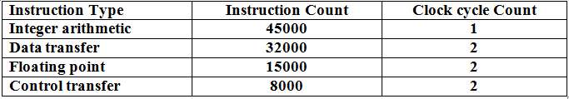
A 400-MHz processor was used to execute a benchmark program with the following instruction mix and clock cycle count:
Total instruction count = 100000
Determine the effective CPI, MIPS rate, and execution time for this program.
2018-05-14

Slide 16
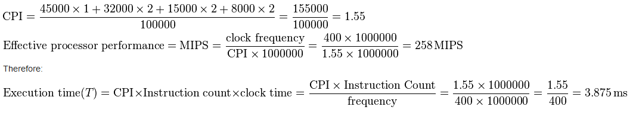
2018-05-14

Slide 17
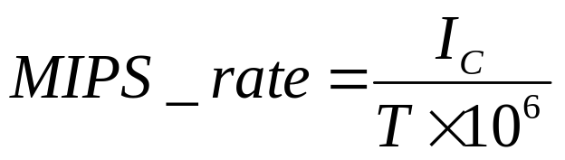
Clock Speed and Instructions per Second
A common measure of performance for a processor is the rate at which instructions are executed, expressed as millions of instructions per second (MIPS), referred to as the MIPS rate
We can express the MIPS rate in terms of the clock rate and CPI as follows:
Consider the execution of a program which results in the execution of 2 million instructions on a 400-MHz processor
The program consists of four major types of instructions
The instruction mix and the CPI for each instruction type are given below based on the result of a program trace experiment
2018-05-14

Slide 18
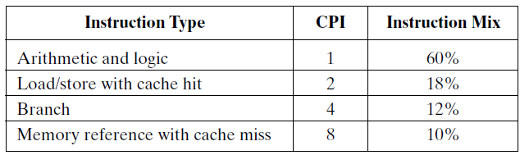
Clock Speed and Instructions per Second
The average CPI when the program is executed on a uni-processor with the above trace results is CPI = 0.6 + (2 × 0.18) + (4 × 0.12) + (8 × 0.1) = 2.24
The corresponding MIPS rate is (400 × 10^6) / (2.24 × 10^6) = 178
2018-05-14

